Slide 1




Composition 101
Welcome!

Slide 2
Homework for Wednesday & Friday
Read pp. 3-26 in Bird by Bird
Journal #1
Quiz over Syllabus
Introductory post on Discussion board
01

Slide 3

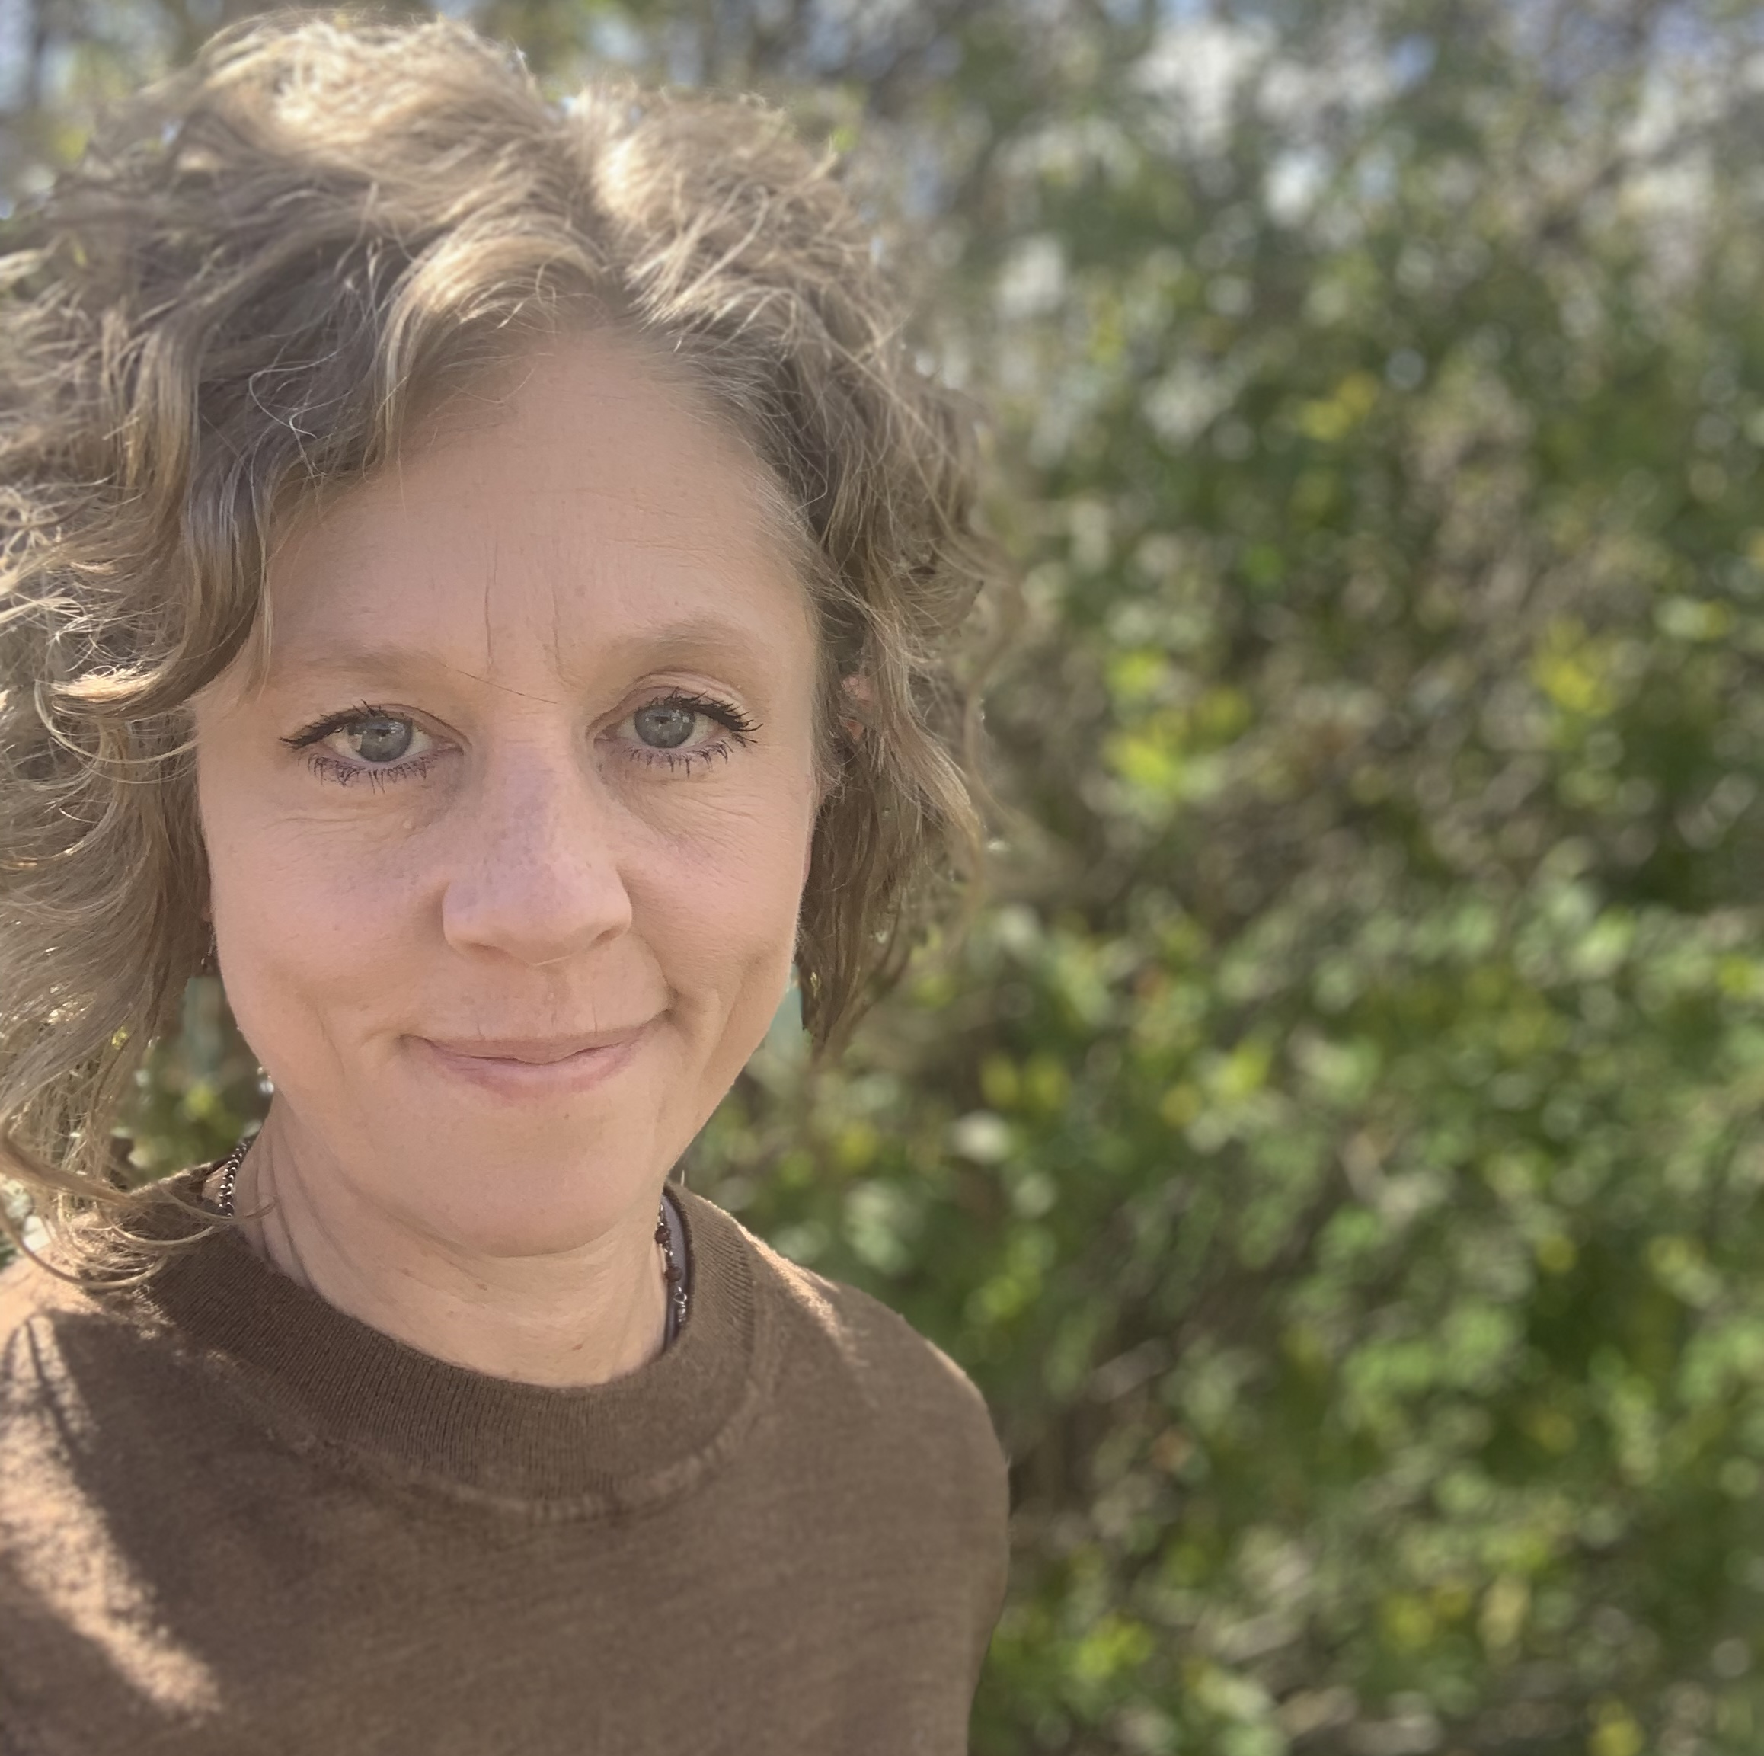

Introductions
Professor Herrick
Teaching at Mines for 14 years
Courses: Composition 101, ENGL 279, ENGL 289
Instructor
Office CB 324
Email: carlie.herrick@mines.sdsmt.edu

Slide 4
Syllabus and Schedule
D2L/Course Home/Syllabus

Slide 5
D2L Features and Where to Find Things
Content
Assessments
Calendar
Communication

Slide 6
Why do we write?
Writing aids critical thinking. (Hui-Chin Yeh, Shih-hsien Yang, Jo Shan Fu & Yen-Chen Shih, “Developing college students’ critical thinking through reflective writing”)
Writing by hand aids memory storage. (Mangen and Velay, “Digitizing Literacy: Reflections on the Haptics of Writing”)
Writing is expected in most engineering fields. (See slide that follows)
Writing can facilitate creativity. (Wang, “Exploring the relationship of creative thinking to reading and writing”)

Slide 7
Engineers and Writing
“[E]ngineers spend between 20% and 40% of their workday writing, a figure that increases as they move up the career ladder [1]. Another study indicates that in their first few years on the job, engineers spend roughly 30% of their workday writing, while engineers in middle management write for 50% to 70% of their day; those in senior management reportedly spend over 70% and as much as 95% of their day writing [2].” JON A. LEYDENS, “Novice and Insider Perspectives on Academic and Workplace Writing: Toward a Continuum of Rhetorical Awareness”

Slide 8

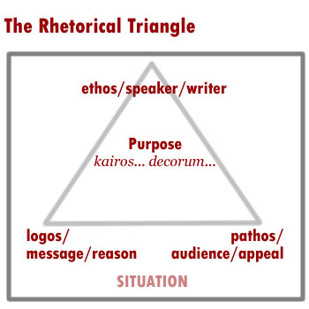
Rhetorical Analysis
Who is your audience?
What genre or type of text is it?
When is it supposed to be submitted? What are the time constraints?
Where will the communication take place? How does the context change the message?
How is the text experienced? Is it electronic communication, multimedia, etc?
Why are you communicating? What is the main purpose?

Slide 9
Assignment Sheet
D2L/Content/Week 1/Day 1

Slide 10
Essay Format
D2L/Content/Week 1/Day 1

Slide 11
Journal #1
What were your experiences with writing and literature in high school? What papers did you write? What were the topics? Did you like the topics? What did you gain from writing these papers?
In the introduction to Bird by Bird, Anne Lamott gives you her literacy narrative. Embedded in her narrative, she offers her observations about writing. What are they?
Please post to dropbox.

